Slide 1
Workbook Expenditures from Gross Profit to EBIT – Total Cost Method (TCM) (Planning)
Internal Use Only
April 2017
EXCEL FILE:

Slide 2
Disclaimer
The content of this workbook has been produced by KPMG Germany/Deal Advisory on the basis of German accounting standards and/or IFRS, as well as considering KPMG Germany’s firm and country requirements, regulations, processes, policies and best practices. Please check your local accounting and other requirements before applying the content.

Slide 3
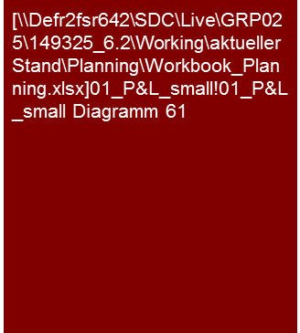
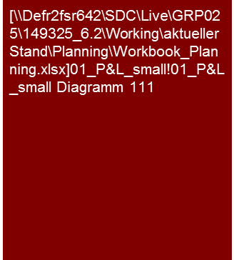
Overview (1/6) – Mission statement
Expenditures from Gross Profit to EBIT Total Cost Method (Planning)
Flag: Total Cost Method (TCM) is a commonly used approach in the DACH region. However, other GAAPs may only accept the CoS approach. Please check your local requirements before applying TCM in your analysis.
Tools listed are commonly used in Germany and may differ in other regions.
Mission Statement:
The goal is to assess the plausibility of the planning of costs and profit margins on the basis of the transparency of the major planning assumptions and their consistency to past, market and competitive analyses
Customer situation
Definition/Methodology/Tools of the basis analysis
Buy Side/Sell Side/JV/Turnaround
Expenditures and margin planning as essential drivers for the derivation of the cash flow and therefore significant drivers for valuations, purchase price determination, assessment of the potential for restructuring
Analysis of the ambitiousness of the planning for negotiations, adjustments of purchase price (e.g. earn outs), internal transactions and tax purposes as well as assessment potential for restructuring
TCM: The earnings attained are compared to the total expenses for the periods. Differences between production and sales are recorded in the change in inventory.
Definition
Expenditures and corresponding operative profit margins (gross profit, EBITDA, EBIT) are to be determined in accordance with the last audit report or on the basis of the definition of the Controlling/ Management Reporting of the target with transition to the definition of the audit report
Pay attention to comparability of the definition to competitors or market studies (e.g. Opex vs. Capex)!
Methodology
Discussions with the persons responsible for planning
Transparent and consistent linking of the results of the competitive analysis from the past analysis and with planning analysis (generally also joint presentation)
Analysis and/or presentation at selected levels (e.g. group, legal entity, segment, profit center, product group, region, etc.) in accordance with the necessity, appropriateness and data situation in the specific case
Concentration on expenses with effect on payment (cash flow), in cases of non-cash expenses assure consistency with balance sheet
Concentration on expenses with significant effect on the development of the margin
Tools
Analysis Toolbox
EBIT and EBIT margin over time
Change in EBIT in the planning period
Degree of standardization
Linking of the past and planning as well as the market and competitive analysis
Provision of Analysis Toolbox
Determination and collection of sector-specific KPIs (Benchmarking Project)

Slide 4
Overview (2/6) – Structure of the P&L analysis and corresponding workbooks
Expenditures from Gross Profit to EBIT Total Cost Method (Planning)
High level P&L analysis
Workbooks for in-depth analysis – Value Driver Tree
Commentary
Explanation of the major trends (sales growth, profitability in % of sales, significant leaps in individual P&L lines), if necessary supplemented by individual operative KPIs and/or benchmarks; very dependent on business model and sector of the specific company
Purpose:
Planning of our analyses and determination of focus
For reporting purposes: Summary (Big Picture/Exec Summary) of the results of the analysis
Workbook ”Sales and Gross Profit"
The detailed analyses should
Improve the comprehension of the business model and the main drivers in the planning
Show the trend of the economic development (monthly or quarterly as necessary)
Allow a meaningful benchmarking by means of suitable categorization of sales
Market development
Sales
x
Price
Trend analysis (with KPIs)
Volume
Gross profit
Differentiated according to product groups, customers, regions
-
Margin (in % of sales)
Costs of materials
According to types of materials
x
Price
EBIT (representing entire P&L)
Volume
-
Workbook "Expenditures from Gross Profit to EBIT"
Analysis should make cost structure and drivers transparent
Headcount (FTEs)
Differentiated according to functions (production/storage, R&D, sales, administration)
Personnel costs
x
Expenditures as per gross profit
Level of remuneration
Other expenditures (+ earnings)
Trend of analysis as per type of expense
e.g. yoy growth, in % of sales, per sqm rental space, etc.
Fixed vs. variable and cost drivers
Workbook "Investments“
Depreciation
Trend in relation to CAPEX
Impairments
Useful life and if necessary modifications of the balance sheets

Slide 5
Overview (3/6) – Analysis puzzle
Expenditures from Gross Profit to EBIT Total Cost Method (Planning)
Market and competitive analysis^{(a)}
Market
Results of analysis
Core statement/Conclusive valuation
Planned/Actual comparison adherence to budget^{(c)}
Comparison
with
past
Comparison with market expectations
Value drivers
Investments and
Depreciation^{(d)}
Planning analysis expenditures & margins
Analysis of past^{(b)}
Scale effects
LTM
Normal- ization^{(e)}
Comparison
with
peers
Current
trading
Product/Segment/
Regions mix
effects
Cost savings potential & synergies^{(f)}
Peer group
Note: a) See Market Analysis workbook; b) see Expenses (CoS or TCM) workbooks; c) see Planning Process and Adherence to Planning workbook; d) see Investments (Planning) workbook; e) see Normalized Earnings workbook; f) see Synergy Management workbook
Scope of the workbooks

Slide 6
Overview (4/6) – Pitfalls
Expenditures from Gross Profit to EBIT Total Cost Method (Planning)
No. | Pitfalls/Lessons learned
 | Comparability: With the analysis of the past and planning as well as the benchmarking of the planning in the market and competitive environment/peer group, the general comparability of the parameters analyzed is to be assured, if necessary by means of adjustments/conversions. Differences may result, for instance, with: The delineation: Differences in financial reporting standards or utilization of accounting options (e.g. presentation as expenses vs. capitalization and depreciation) The information shown: Differing accounting standards or utilization of balancing options or latitude (e.g. reporting as expense vs. capitalization and depreciation, differing realization of sales, etc.) The fundamental design and arrangement of economically identical/similar issues: Various measures for achieving the same economic result (e.g. acquisition vs. leasing/rental, borrowing vs. factoring) A lack of complete comparability (e.g. lack of information about the impact of options, etc. with peers that appear to be significant) is to be mentioned and appropriately recognized (e.g. “only limited validity“).
 | Planning depth: Frequently, the first planning year (budget) is detailed and therefore planned realistically or even conservatively because other processes are based on them (remuneration, metrics, target attainment) and measurement can be made promptly (current trading). Subsequent planning years are generally not included here and are frequently based on a reduced depth of the planning assumptions. They are often planned generally, frequently much “more fancifully” (higher growth, increase in margins,…→ “hockey stick“) (similar to a strategic outlook) and therefore should be viewed more critically.
 | Materiality: With the analysis of the past and planning as well as the benchmarking of the planning in the market and competitive environment/peer group care should be taken that these are only performed for main products/product groups/segments/regions. Furthermore, with the analysis and presentation of the various types of costs, the focus should be on the triggering types of costs of the essential and significant profit/margin changes. No expansive descriptions of non-essential items simply because you know a lot about it!
 | Inflation: Frequently, inflation-based cost increases are not considered in the client’s planning. This is to be scrutinized carefully (e.g. anti-cyclic increases in efficiency) and adjusted if necessary.
 | Intention: Generally a more optimistic picture of the future developmental potential of the target is shown and positive aspects especially emphasized in the framework of sell-side clients. While for buy-side clients planning is scrutinized especially critically and tends to be viewed pessimistically. In both cases, it may come to adjustments of the client planning, scenarios or references to these in our reports.
 | Transition actual to plan: Frequently, the first planning year/budget is not based on audited results from the previous actual year, but rather on a forecast/extrapolation for the previous actual year. Frequently, the audited results and forecast/extrapolation for the previous actual year deviate from one another. Breaches may then occur between the previous actual year and first planning year/budget that may have to be adjusted in case of materiality (adjustment of planning, P&L and balance sheet).
1
2
3
4
5
6

Slide 7






Overview (5/6) – Core issues
Expenditures from Gross Profit to EBIT Total Cost Method (Planning)
Core Issue | Specific analysis | Page(s)
Are the planned expenditures, cost/income ratios and the resulting planned profit margins plausible developments from the past? | Comparison of planned margins with the margins attained in the past Analysis of significant drivers (e.g. price and volume effects, portfolio effects, main effects, etc.) and checking of plausible development or assumptions What types of expenditures should contribute to changes in margins (analysis of type of expenditure in % of sales over time per type of expense) Analysis of operational leverage (percentage of fixed vs. variable, fixed cost digression), possible scale effects, etc. over time based on past analysis Are cost reductions (and increases in margins) based on corresponding measures? Have these measures already been decided upon/approved? Transition of the previous actual year to planning year(s) – e.g. Waterfall Chart (Link to Sales and Gross Profit workbook, Normalized Earnings workbook) | 9 – 15
2. Are the planned types of expenditures and the resulting margins consistent with the market expectation and competitors? | Compare expense planning (e.g. personnel costs per FTE, in % of sales and similar) as well as resulting margins (EBITDA, EBIT margins) to market studies, analyst expectations, KPIs from peer group companies (benchmarking) Note: pay attention to uniform definition and if necessary balancing (Opex vs. Capex) of costs as well as profit margins with peers and the companies! Identify, analyze and justify explanation for possible deviations to market expectation (e.g. balancing, leasing, scale effects, etc.) | 16
Does the current trading/LTM or the current forecast support the cost and profit planning? | Compare current trading (if necessary, extrapolation for entire year) or current forecast with costs and profit margin planning | 17 - 19
360° CQ
360° CQ
360° CQ

Slide 8
Overview (6/6) – Core issues
Expenditures from Gross Profit to EBIT Total Cost Method (Planning)
Core Issue | Specific analysis | Page(s)
Are the personnel costs planned plausibly? Is the headcount planning plausible in relation to the sales planning (sufficient capacity)? Have collective bargaining increases been given proper consideration? | Analysis of productivity per employee (e.g. earnings per employee) in course of planning with comparison to peers and past Analysis of personnel costs per employee in course of planning if applicable compared to peers and past and align with collective bargaining agreements Analysis of pension costs, semi-retirement arrangements, etc., if significant Analysis of restructuring programs, if relevant | 20 – 22
Has other operating result been plausibly planned? Are “infrastructure expenses“ (e.g. IT, rent) consistent with the capacities needed? | Analysis of composition of other operating result Analysis of cost increases of the individual items Has the fixed/stepped character of the other operating result been reflected appropriately (scale effects, fixed cost digression, etc.)? Analysis of dependencies of costs using KPIs, e.g. IT or rent per employee and such. Analysis of restructuring programs, if relevant Analysis of other operating income, especially if sales-dependent or special issues e.g. dissolution of provisions, liquidation of special items (no cash flow effect, assure consistency with balance sheet planning!) etc. | 23
Has depreciation been plausibly planned? | Analysis of differences in depreciation as of commercial and tax balance Assure that depreciation was considered in the same amount in the development of the fixed assets to avoid cash flow effect Simulation for existing fixed assets Depreciation planning for investments in the planning period on the basis of typical or useful lives applied to date No cash flow effect, but relevant for correct derivation of taxes | 24 - 26
360° CQ
360° CQ

Slide 9
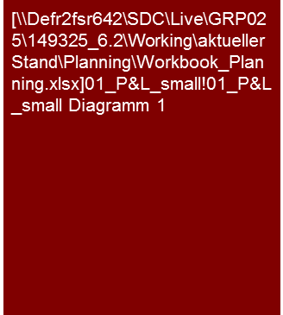
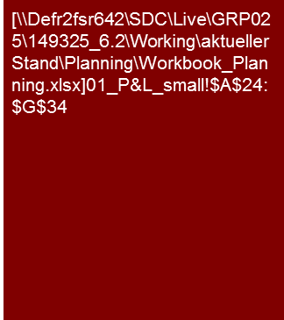
1. Are the planned expenditures, cost/income ratios and the resulting planned profit margins plausible developments from the past? (1/6)
Expenditures from Gross Profit to EBIT Total Cost Method (Planning)
The XXX AG planning reflects a distinct increase of the gross profit margin from x% to y% caused by XXX.
This should also lead to an increase of the EBIT margin from x% to y% in the planning period.
Considering the results achieved in the past, we consider the XXX AG planning to be ambitious.
Operating plan XXX AG
Operating plan
xxx
Actual
Plan
Instead of EBIT, presentation of EBITDA may also be recommendable
Tools
Excel analysis

Slide 10
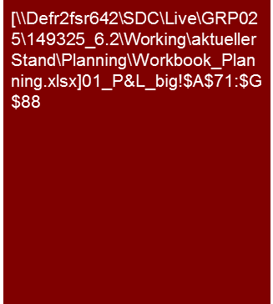
1. Are the planned expenditures, cost/income ratios and the resulting planned profit margins plausible developments from the past? (2/6)
Expenditures from Gross Profit to EBIT Total Cost Method (Planning)
The XXX AG planning reflects a distinct increase of the gross profit margin from x% to y% caused by XXX.
This should also lead to an increase of the EBIT margin from x% to y% in the planning period.
Considering the results achieved in the past, we consider the XXX AG planning to be ambitious.
Alternative
1
2
Profit and loss statement
The XXX results in an increase of the gross profit margin in the planning period.
The increase of the other operating income in 2015 is caused by XXX
1
2
Highlight material effects (circle, numerate, etc.)
Tools
Excel analysis

Slide 11
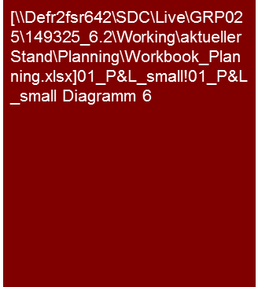

1. Are the planned expenditures, cost/income ratios and the resulting planned profit margins plausible developments from the past? (3/6)
Expenditures from Gross Profit to EBIT Total Cost Method (Planning)
The XXX AG planning reflects a distinct increase of the gross profit margin from x% to y% caused by XXX.
This should also lead to an increase of the EBIT margin from x% to y% in the planning period.
Considering the results achieved in the past, we consider the XXX AG planning to be ambitious.
EBIT and EBIT margin over time
Development of EBIT margin
The EBIT should be increased from €8.5 million in 2012 to €13 million in 2015 in the course of planning.
Some major causes for the expected profit increase are scale effects and the improvement of procurement conditions. Increases in collective bargaining in personnel costs as well as the expected price reductions for product X have a compensatory impact.
Overall, an improvement of the EBIT margin is expected from 15.2% in 2012 to 19.4% at the end of the planning period, whereby the EBIT margin of 2012 represents the highest EBIT margin ever attained in the history of XXX AG.
The expected scale effects are primarily expected in XXX. They are to be achieved through XXX measures.
[...details about improvements in procurement conditions...]
[...details about collective tariffs increase...]
[...details about price reduction of product X...]
Actual
Plan
Change in EBIT in the planning period
Instead of EBIT, presentation of EBITDA may also be recommendable
Presentation of essential elements in the bridge. If applicable, presentation across the entire slide with a copy below for majority of essential elements
Tools
Excel analysis

Slide 12

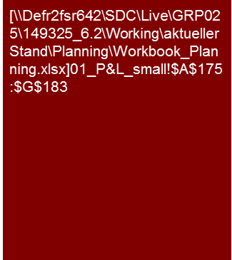
1. Are the planned expenditures, cost/income ratios and the resulting planned profit margins plausible developments from the past? (4/6)
Expenditures from Gross Profit to EBIT Total Cost Method (Planning)
The expected improvement of the EBIT margin in the planning period should primarily be attained by a reduction of the material cost ratio.
A package of measures has been developed to that end and the implementation initiated.
If applicable estimation realistic/ambitious/plausible/ reproducible…
Change of EBIT margin compared to previous year
Change of EBIT margin
The expected increase of the EBIT margin in the planning period is primarily attributable to the change in gross profit margin
The expected improvement of the cost of material ratio is caused by XXX
The personnel expenses initially increase disproportionally in the course of planning compared to sales. In 2015, however, a reduction of the personal expenses ratio should be attained by XXX.
Actual
Plan
Instead of EBIT, presentation of EBITDA may also be recommendable
Tools
Excel analysis

Slide 13
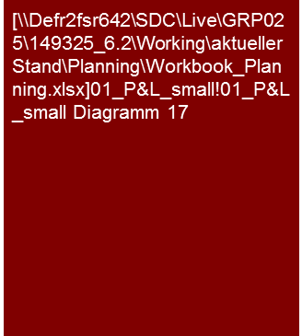
1. Are the planned expenditures, cost ratios and the resulting planned profit margins plausible developments from the past? (4/6)
Expenditures from Gross Profit to EBIT Total Cost Method (Planning)
Alternative presentation:
Change of the gross profit margin instead of costs of sales ratio
The expected improvement of the EBIT margin in the planning period should primarily be attained by a reduction of the material cost ratio.
A package of measures has been developed to that end and the implementation initiated.
If applicable estimation realistic/ambitious/plausible/ reproducible…
Change of EBIT margin compared to previous year
Change of EBIT margin
The expected increase of the EBIT margin in the planning period is primarily attributable to the a decrease in the cost of materials ratio
The expected improvement of the gross profit margin is caused by XXX
The administration costs initially increase disproportionally in the course of planning compared to sales. In 2015, however, a reduction of the administration costs ratio should be attained by XXX.
Actual
Plan
Instead of EBIT, presentation of EBITDA may also be recommendable
Tools
Excel analysis

Slide 14


1. Are the planned expenditures, cost ratios and the resulting planned profit margins plausible developments from the past? (5/6)
Expenditures from Gross Profit to EBIT Total Cost Method (Planning)
The expenditures of the XXX AG are primarily for cost of sales.
A shift from external performance to own performance is assumed in the course of planning.
This appears plausible in view of the strategic reorientation approved.
Composition of expenditures
Development of the types of expenses and cost/income ratios
The costs of materials are primarily caused by XXX. The increase in the costs of materials originates from XXX.
The planning of the costs of materials results on the basis of XXX
[...Personnel expenses 1-2 bullet points...]
[...Other operating income 1 sentence (due to subordinate importance)...]
[...depreciation 1 sentence (due to subordinate importance) and reference to explanations capex & depreciation (see Investments workbook)...]
Actual
Plan
Development of the cost/income ratios
Actual
Plan
These should be analyzed and presented separately (compositions, development, etc.) in cases of major changes of individual types of expenses with impacts on margins.
Tools
Excel analysis

Slide 15

1. Are the planned expenditures, cost/income ratios and the resulting planned profit margins plausible developments from the past? (6/6)
Expenditures from Gross Profit to EBIT Total Cost Method (Planning)
The major portion of the intended cost reductions have been based on measures.
With regard to the cost reduction measures, the major portion are for XXX.
Cost reduction measures
Measures planned
60% of the cost reductions considered in the planning are based on measures. For the remaining 40%, it is intended to develop measures in the framework of XXX by YYY.
The cost reduction measures approved to date primarily contain a successive reduction of the personnel by XXX with a cost reduction effect of €XX million in the planning period. Furthermore, by means of renegotiating with vendors, savings of €YY million should be attained.
[...description of measure 1 (length corresponds to importance)...]
[...description of measure 2 (length corresponds to importance)...]
[...description of measure 3 (length corresponds to importance)...]
Tools
Excel analysis

Slide 16
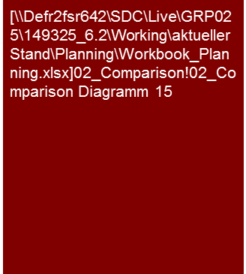

2. Are the planned types of expenditures and the resulting margins consistent with the market expectations?
Expenditures from Gross Profit to EBIT Total Cost Method (Planning)
The planned EBIT margin of the XXX AG is higher than that of the competitors’ average.
The expected development of the EBIT margin in the planning period shows a comparative trend for the competitors.
The margin expectation lies above…, by approx. x %-points, also above the average expectations of the analysts for the XXX AG.
Based on the statements above, we consider the planned EBIT margin of the XXX AG to be ambitious/ optimistic/realistic/plausible/ conservative/cautious/….
EBIT margin in comparison to peer group
Competitors of the XXX AG show an EBIT margin in a range of X% to Y%. The expected margin for the XXX AG is within this range, above the average. This has already been the case in the past.
The reasons for the above-average margin of the XXX AG compared to the competition are XXX
Increasing margins are expected for all the competitors in the future. This coincides with the expectations of the XXX AG
Analysts expect on average a, for the most part, constant EBIT margin of 16% for the XXX AG and therefore below the margin expectations of the XXX AG.
The expectations of the analysts with regard to the amount and trend of the EBIT margin are, however, not uniform. The margin expectations of the analysts range from X% to Y%. This means, in some cases rising margins, in other cases falling margins are expected.
The reasons for the heterogeneity of the analysts predictions are the differing expectations with regard to XXX
EBIT margin in comparison to analysts' expectations
Tools
Excel analysis

Slide 17
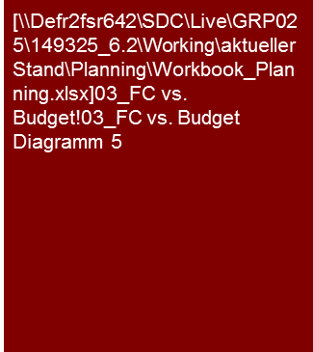
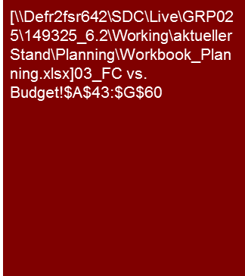
3. Does the current trading/LTM or the current forecast support the cost and profit planning? (1/3)
Expenditures from Gross Profit to EBIT Total Cost Method (Planning)
In view of the current business development, the 2013 budget appears to be very ambitious.
The current forecast reflects the results that were below the budget for 2013.
No consequences are expected for the other planning years.
Comparison forecast vs. budget
Current business development
The current business development in the first half of 2013 is below the expectations of the XXX AG. This is primarily due to XXX.
The current business development that is below expectations is also reflected in the adjusted forecast, which is below the budget. The sales expected is now €x.x million or ca. X% and the EBITDA ca. €x.x million or ca. X% below budget.
In the forecast of the EBITDA, it should be noted that along with the business development, there are personnel costs above expectations due to the early conclusion of the collective bargaining agreement and encumbrances from the litigation XXX.
The management of XXX AG does not expect any consequences for the planning years 2014 and 2015 to result from the failure to meet the budget in 2013. We agree to this estimation on the basis of the information provided to us and with the analyses we performed.
Tools
Excel analysis

Slide 18
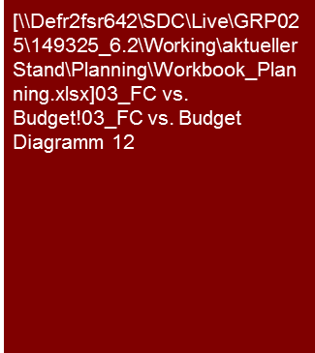

3. Does the current trading/LTM or the current forecast support the cost and profit planning? (2/3)
Expenditures from Gross Profit to EBIT Total Cost Method (Planning)
On EBITDA level budget 2013 is supported by current forecast, while EBIT is adjusted upwards in the forecast compared to budget due to lower than expected depreciation.
Comparison forecast vs. budget (absolute)
The expected EBITDA and the expected EBITDA margin for the 2013 forecast are slightly above the budgeted value. The reason for this is XXX.
According to the management and our analyses, these effects do not have any consequences for the subsequent planning years.
The EBIT for forecast 2013 is, with €X million ca. €X million above the budgeted value of €X million.
The EBIT margin of the forecast 2013 is, with 17.7% ca. 0.8%-points above the budgeted value of 16.9%.
The primary reason for this is, along with the EBITDA margin that is slightly above expectations, the depreciation that is lower than budgeted. These were caused by XXX.
As a result of the effects described we now expect that the depreciation for the subsequent planning years will be lower. We/The management of the XXX AG have adjusted the planning appropriately.
Expenses
Profit
Comparison forecast vs. budget (margin)
Expenses
Profit
Tools
Excel analysis

Slide 19
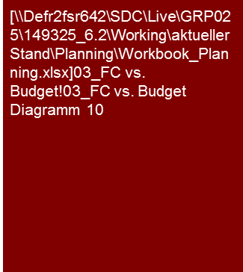
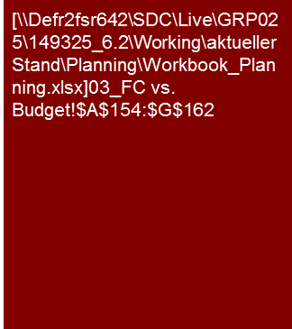
3. Does the current trading/LTM or the current forecast support the cost and profit planning? (3/3)
Expenditures from Gross Profit to EBIT Total Cost Method (Planning)
The XXX AG already has ca. two-thirds of the budget for 2013 in the first half year. The reason for this is the high percentage of the Easter business on the entire annual success. The degree of budget attained for the first half year is comparable to the figure of the previous year.
On the basis of the current profit situation, it is expected that the 2013 budget will be attained.
YTD June 2013
Description
xxx
Tools
Excel analysis

Slide 20
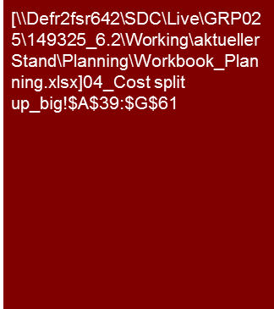
4. Are the personnel costs planned plausibly? (1/2)
Expenditures from Gross Profit to EBIT Total Cost Method (Planning)
The XXX AG planning takes into consideration an increase in headcount of ca. 15% and average increases in wage rates of X% p.a.
The earnings per employee and the contribution margin per employee should increase by ca. X% or Y% in the course of planning. The reason for this is an increasing degree of automation.
We consider the personnel planning to be ambitious/ optimistic/realistic/plausible/ conservative/cautious/….
The XXX AG plans to increase headcount across all the segments. The total increase in headcount in the course of planning will be ca. 15% from 439 FTE to 506 FTE. The expansion is planned especially in the area of development engineers.
The sales per FTE are initially relatively stable in the first two planning years compared to the level attained in the past. Here, a clear decrease in Segment B caused by XXX and an increase in Segment C caused by YYY compensate one another.
In the final planning year, an increase in sales per FTE, caused by XXX, is expected in every segment.
The average personnel expenses per FTE is highest in Segment C due to the high percentage of engineers compared to assembly line workers. As a result of the wage rates applicable group-wide and similarly planned new hires, the development of personnel expenses per FTE is comparable for all segments. The personnel expenses per FTE increases in the course of the planning period an average of X% p.a.
As a result of the high degree of automation, the contribution margin per FTE is highest in Segment B as the sales per FTE.
With XXX, it is expected that there will be a further expansion of the contribution margin per FTE in the planning period, while this will remain relatively constant in Segment A and will even sink in Segment B. This is caused by X and Y.
Overall there is a slight increase of the contribution margin per FTE in the group of € X in 2012 to € Y in 2015.
Tools
Excel analysis
Alternative presentation to segments also possible for regions, functions, etc.
Perform analogously to detailed analyses for other function costs, if significant and reasonable

Slide 21


4. Are the personnel costs planned plausibly? (2/2)
Expenditures from Gross Profit to EBIT Total Cost Method (Planning)
The planned sales per FTE of the XXX AG is, as in the past, above the average for the competition.
At the same time the planned personnel expenses are comparable to the average level of the competitors.
Based on that, we consider the personnel planning of the XXX AG to be ambitious/ optimistic/realistic/plausible/conservative/cautious/….
Sales per FTE in comparison to peer group
xxx
Personnel expenses per FTE in comparison to peer group
Perform analogously to detailed analyses for other function costs, if significant and reasonable
Tools
Excel analysis

Slide 22


4. Are the personnel costs planned plausibly? (2/2)
Expenditures from Gross Profit to EBIT Total Cost Method (Planning)
The planned sales per FTE of XXX AG is, as in the past, above the average for the competition.
At the same time the planned personnel expenses per FTE are comparable to the average level of the competitors.
Based on that, we consider the personnel planning of the XXX AG to be ambitious/ optimistic/realistic/plausible/ conservative/cautious/….
Sales per FTE in comparison to peer group
xxx
Alternative
Actual
Plan
Personnel expenses per FTE in comparison to peer group
Actual
Plan
Tools
Excel analysis

Slide 23
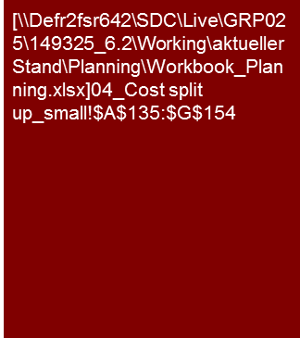
5. Has other operating result been plausibly planned?
Expenditures from Gross Profit to EBIT Total Cost Method (Planning)
The other operating result is primarily influenced by the development of XXX and YYY.
xxx
The other operating result is primarily due to XXX and YYY. As a result of scale effects there is a below average increase compared to sales in the course of planning.
[.... explanations on the material individual items and development in the planning period ....]
[.... explanations for KPIs or dependencies on individual items from other parameters ....]
Choice of parameters for major expenses on the basis of specific drivers, usually sales or employees
Tools
Excel analysis

Slide 24
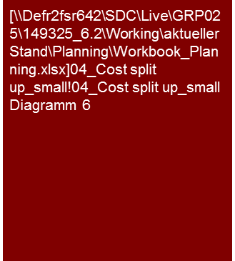
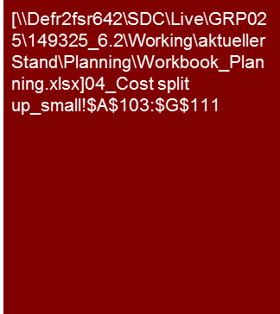
6. Has depreciation been plausibly planned? (1/3)
Expenditures from Gross Profit to EBIT Total Cost Method (Planning)
The XXX AG plans to expand investments in the planning period to reduce the existing investment backlog. Depreciation increases respectively in the course of the planning.
We consider the investment and depreciation planning to be XXX.
Depreciation and investments over time
XXX AG expects a significant increase of the investments above the level of depreciation/average investment in the past, as a result of the successive reduction of the investment backlog. These are primarily for XXX.
As a result of the investment activity the assets increase by ca. X% in the planning period.
The investments are primarily in XXX. They are above the level of depreciation/average investment in the past as a result of the successive reduction of the investment backlog.
[.... expansion vs. replacement investments .....]
[.... Additional explanations of investments ...]
[.... explanations of investments, depreciation method and assumed useful life ....]
[... Reproduction of complete investment cycle? Length of planning horizon? Transition to sustainable result → s. workbook Sustainable Result ...]
The depreciation increased slightly in the course of planning as a result of the investment sum being higher than depreciation.
Due to the high assumed useful life of the planned expansion investments the depreciation ratio increased only slightly compared to the investment ratio.
[.... explanations of depreciation and investment ratio (investments in% of sales ....)]
Actual
Plan
Note: (a) Depreciation ratio = Depreciation/Sales
(b) Investment ratio = Investments/Sales
Tools
Excel analysis

Slide 25
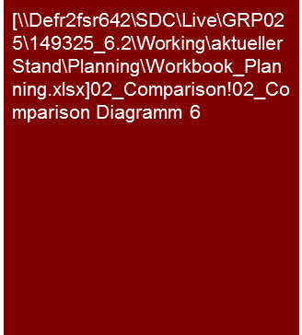

6. Has depreciation been plausibly planned? (2/3)
Expenditures from Gross Profit to EBIT Total Cost Method (Planning)
Volume and development of the depreciation and investment ratio of the XXX AG are comparable to that of competitors.
Based on these statements/data/assumptions, we consider the investment and depreciation planning of the XXX AG to be ambitious/optimistic/ realistic/plausible/ conservative/cautious/….
Depreciation ratio in comparison to peer group
[….Explanation of depreciation and investment compared to competition XXX if applicable explanation of differences in balancing (Opex vs. Capex), financing (purchase vs. lease/rental), etc. …]
Investment ratio in comparison to peer group
Tools
Excel analysis

Slide 26

6. Has depreciation been plausibly planned? (3/3)
Expenditures from Gross Profit to EBIT Total Cost Method (Planning)
Volume and development of the depreciation and investment rate of the XXX AG are comparable to that of analysts’ expectations.
Based on these statements/data/assumptions, we consider the investment and depreciation planning of the XXX AG to be ambitious/optimistic/ realistic/plausible/ conservative/cautious/….
Investment rate in comparison to analysts' expectations
XXX
Tools
Excel analysis

Slide 27
© 2017 KPMG International Cooperative (“KPMG International”). KPMG International provides no client services and is a Swiss entity with which the independent member firms of the KPMG network are affiliated.

